Slide 1
City of Talent
VAR 2015-001
Suncrest Homes
Planning Commission
October 22, 2015

Slide 2
Background
Subject parcel was created from a 0.43 acre parcel as part of a flaglot partition in October 2006
Lot is approximately 10,019 square feet (exceeds minimum lot size by 21%)
Lot is zoned RS-5 (8,000 square foot minimum)
2006 condition allows only a single story dwelling

Slide 3
Site Information

Slide 4
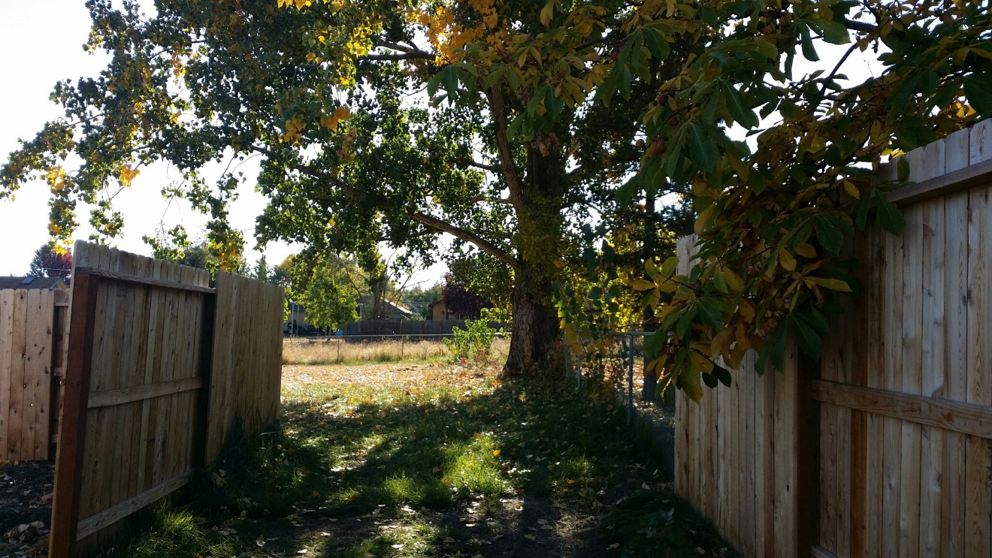
Property Characteristics

Slide 5
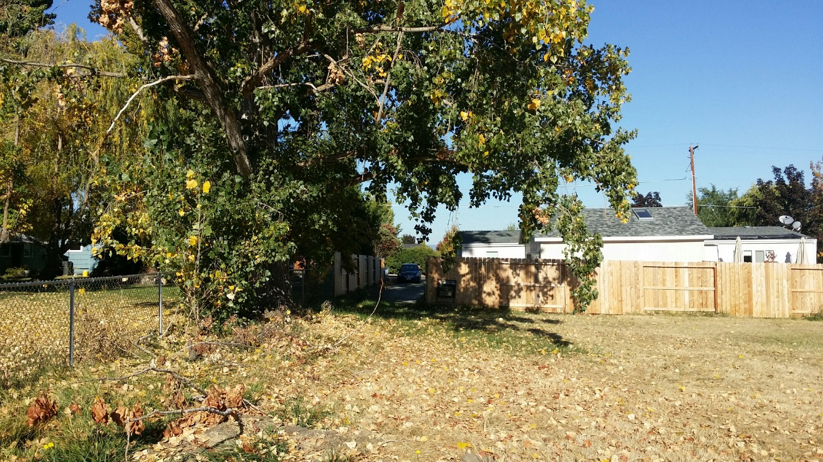
Property Characteristics

Slide 6
Approval Criteria
8-3 Division L. Article 4 of the Talent Zoning Ordinance regulates Variances.
8-3L.440 REQUIRED FINDINGS FOR GRANTING A VARIANCE
The Planning Commission shall not grant any variance unless all of the following findings are made:
A. There are exceptional or extraordinary circumstances or conditions applying to the property or intended use that do not apply generally to other properties in the same zone or vicinity and which result from lot sizes or shape legally existing prior to the adoption of this chapter, topography, or other circumstances over which the applicant has no control;

Slide 7
Approval Criteria
8-3 Division L. Article 4 of the Talent Zoning Ordinance regulates Variances.
8-3L.440 REQUIRED FINDINGS FOR GRANTING A VARIANCE
The Planning Commission shall not grant any variance unless all of the following findings are made:
B. The variance is necessary for the preservation of a property right of the applicant which is substantially the same as is possessed by the owners of other property in the same zone or vicinity;

Slide 8
Approval Criteria
8-3 Division L. Article 4 of the Talent Zoning Ordinance regulates Variances.
8-3L.440 REQUIRED FINDINGS FOR GRANTING A VARIANCE
The Planning Commission shall not grant any variance unless all of the following findings are made:
The variance would not be detrimental to the purposes of this chapter, the objectives of any City development plan or policy, the goals, policies or text of the Comprehensive Plan, or other property in the zone or vicinity in which the property is located; and

Slide 9
Approval Criteria
8-3 Division L. Article 4 of the Talent Zoning Ordinance regulates Variances.
8-3L.440 REQUIRED FINDINGS FOR GRANTING A VARIANCE
The Planning Commission shall not grant any variance unless all of the following findings are made:
D. The variance requested is the minimum variance from the provisions and standards of this chapter, which will alleviate the hardship.

Slide 10
Proposed Site Plan

Slide 11
Proposed Conditions
ONGOING CONDITIONS OF APPROVAL:
1. The applicant shall continually provide turn-around access between the dwelling and western property line, to prevent backing out of the flag lot access.

Slide 12
Recommendation & Motion
Recommendation
Based on the findings for the Variance stated in the Proposed Final Order, staff recommends approval of the Variance, with conditions outlined in the Proposed Final Orders
Proposed Motion
“I move to approve the application for a variance allowing a setback of 8’ -9” on the eastern boundary of the subject parcel as proposed.”

